Slide 1

The Increasing Political Divide in the United States
And why we should care
Notes:
Introduce yourself, don’t be nameless

Slide 2
Introduction and Overview
America has become increasingly polarized over time
How this affects us (and why we should care)
Funny tables to show the danger
Notes:
Keep this bit short, focus efforts on following slides

Slide 3
America’s Polarization Over Time
The US has become increasingly polarized.
Political discourse has become more hostile
America will soon reach a breaking point
Notes:
Give examples: Reagan, Bush, increasing divined since 9/11,, Puloski rip
Talk about online discourse
Hearken back to civil war and late Republic Rome

Slide 4
What happens now?
How this Effects Us
Why We should care
As the US radicalizes, we follow suit
This effects how we conduct our politics
Our relationship is affected based on radicalization
We have an example of the effects of radicalization
We share our entire land border
Notes:
1, Echo effect superpower effect
2, increased smear tactics today
3, Trump Trade War
4, remind people how bad it is down south
5, elaborate on civil war, both sides claiming obligations, spillovers, refugees and flareups, what if we choose wrong side

Slide 5
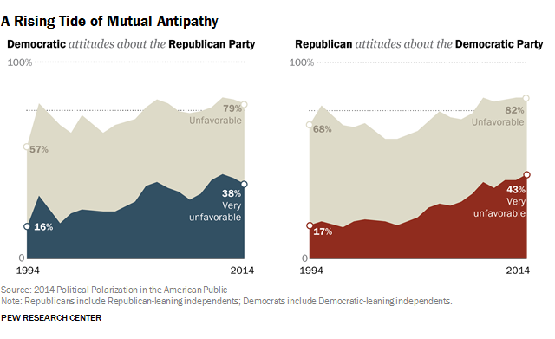
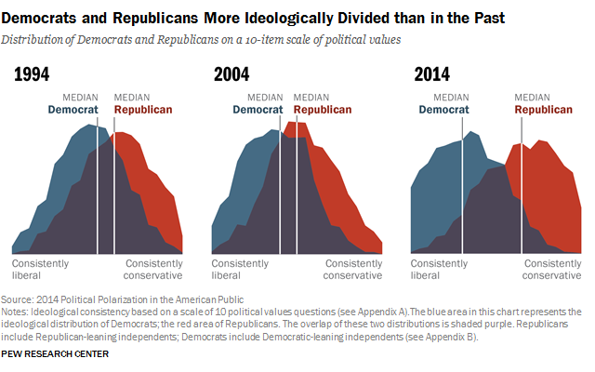
Graphs and Charts(with references)
Political Polarization in the American Public | Pew Research Center
https://www.pewresearch.org/politics/2014/06/12/political-polarization-in-the-american-public/
Notes:
Chart 1 note the radicalized attitude over time. Compare to pre-civil war and comparatively fewer hot button issues
Chart 2 Note the massive swing from 2004-2014 as opposed to 94-04. remind that it’s 2024 now and what that chart might look like

